Slide 1
Red Wine Quality
Team 01-07
Emma Holt, Daniel Kuzjak, Jing Li and Jonny Mills

Slide 2
Outline
Introduction
Business Problem
Gathering data
Modeling Steps
Exploratory analysis
Model selection
Feature selection
Interpretation
Application

Slide 3
introduction
Business Problem
Gathering Data

Slide 4


Slide 5
Business Problem
Motivation behind wine quality dataset
Considerable market size
Importance in culture
Notes:
Emphasis on the customer standpoint

Slide 6
Business Problem
Motivation behind wine quality dataset
Considerable market size
Importance in culture
The problem
It can be difficult to determine the quality of wine just by looking at the bottle
Notes:
Emphasis on the customer standpoint

Slide 7
Business Problem
Motivation behind wine quality dataset
Considerable market size
Importance in culture
The problem
It can be difficult to determine the quality of wine just by looking at the bottle
Solution
We will develop a model to classify red wine quality for customers before they buy it
Notes:
Emphasis on the customer standpoint

Slide 8
Gathering Data
Data Source
Obtained from Kaggle.com
Clean data with no missing fields
Predictors
11 different types of wine ingredients
All numeric

Slide 9
Gathering Data
Response variable
Output is a median of at least three evaluations made by wine experts.
Each expert rated the wine quality on a scale from 3 to 8, 3 being the worst, and 8 the best
Grouped into two classifications: High quality and normal quality
Score above a 6 to be “high quality”

Slide 10
Modeling steps
Exploratory Analysis
Model Selection
Feature Selection

Slide 11
Exploratory Analysis
Prior knowledge from consumers standpoint
Alcohol level, pH values, residual sugar level, and density
Important for the latter modeling procedures
Normality, uniform variance for each class
Could potentially harm accuracy
Could potentially violate assumptions
Notes:
Talk about why this step is necessary

Slide 12
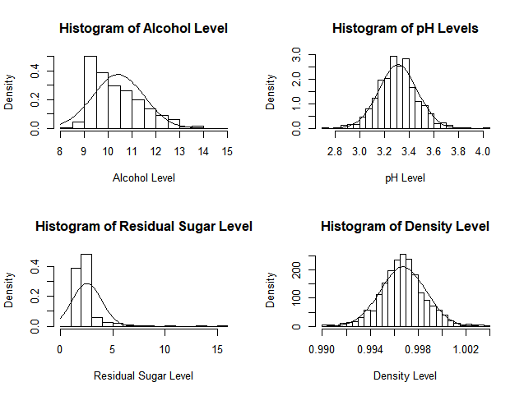
Exploratory Analysis
Histogram of alcohol level and residual level are skewed right
Possibly affected by outliers and high leverage points
Data could be biased – Type I, II error
Notes:
Displays distribution of each predictor, not by class

Slide 13
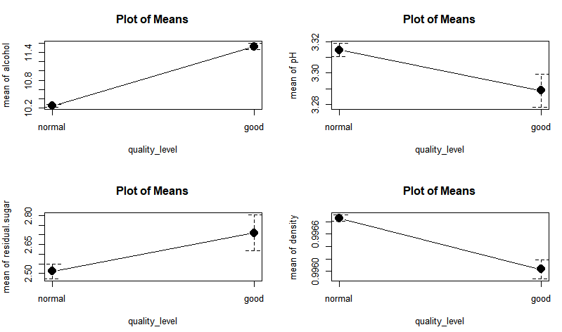
Exploratory Analysis
Using ANOVA, it is observed that alcohol level, and density levels were statistically significant by class
Higher quality wine tends to have more alcohol and a lower density level

Slide 14
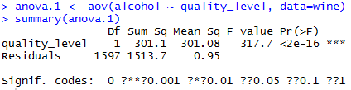
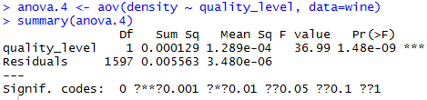
Exploratory Analysis

Slide 15


Exploratory Analysis
Bartlett’s test
Comparing the variance of two or more samples
The test has the null hypothesis that the variances are equal
Normal quality
High quality
Notes:
The group variance between classes are not uniform

Slide 16
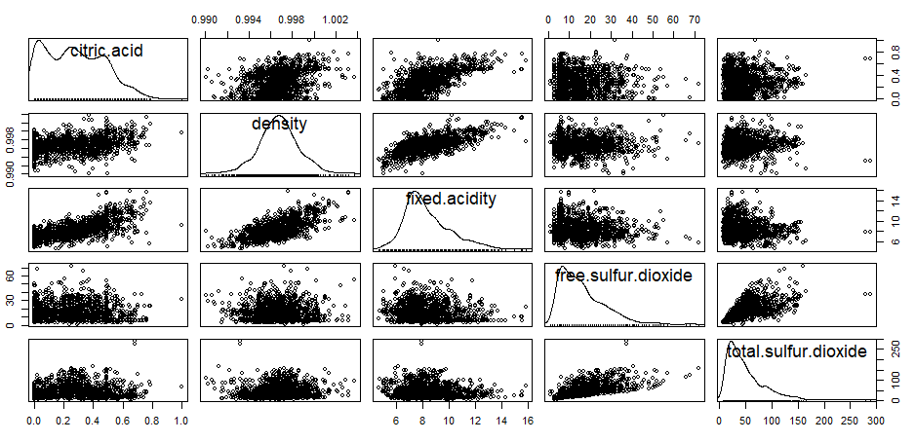
Exploratory Analysis
Notes:
Correlation between….
Could reduce the test MSEs for the logistic model

Slide 17
Exploratory Analysis
Correlation between:
Citric acid and fixed acidity
Density and fixed acidity
Free sulfur dioxide and total sulfur dioxide
Multicollinearity could potentially harm the accuracy of parameter estimates

Slide 18
Model Selection
LDA, QDA
We already know that the group variance between response classes are not uniform
Test error rate for QDA is 0.178
Test error rate for LDA is 0.140

Slide 19
Model Selection
KNN
80% training data, 20% test data
Best model occurred when k=1
Test error rate is 0.134
Our goal is to improve logistic regression and use it to compare against the KNN model

Slide 20
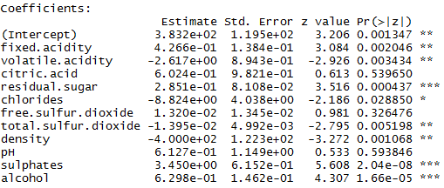
Model Selection
Logistic regression
Full model
Test error rate is 0.143

Slide 21
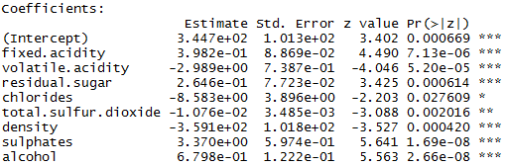
Model Selection
Logistic regression
Reduced model
Test error rate is 0.134

Slide 22

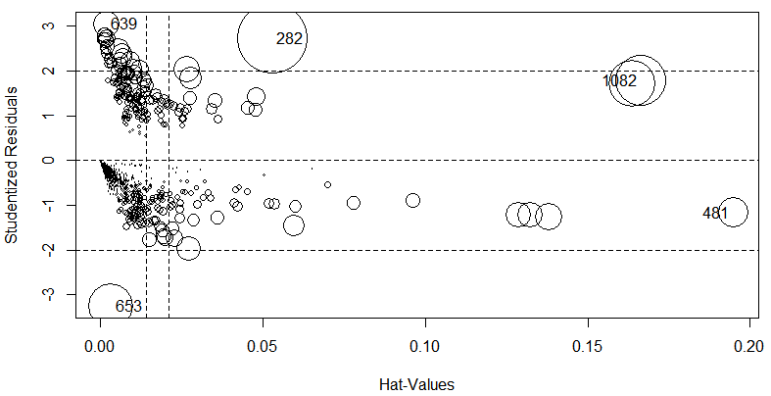
Model Selection

Slide 23
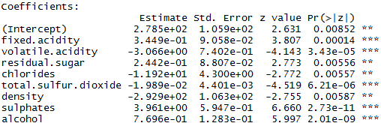
Model Selection
Logistic regression
Reduced model without high leverage points and outliers
Test error rate is 0.112

Slide 24
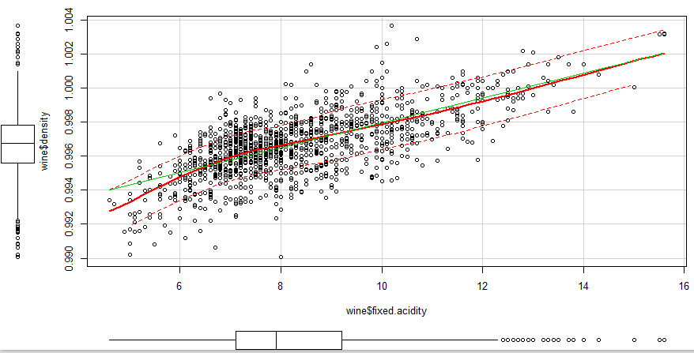
Model Selection
Interaction terms
Citric acid and fixed acidity
Density and fixed acidity
Free sulfur dioxide and total sulfur dioxide

Slide 25
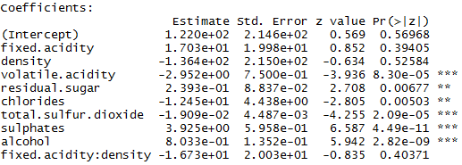
Model Selection
Logistic regression
Reduced model
Without high leverage points and outliers
With interaction terms

Slide 26
Model Selection
Examining possibilities including higher power terms
Logistic regression
Reduced model
Without high leverage points and outliers
With higher power terms
Test error rate is still 0.112
Cross validation, test error rate is 0.085

Slide 27
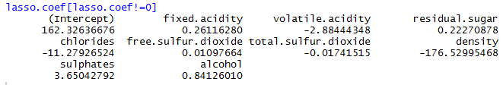
Feature Selection
One intuitive question to ask:
Possibility let the model to choose features
The Lasso
Test error rate is 0.106
pH and citric acid are excluded, same suggested by logistic
Lowest lambda is 0.00147
Ridge
Lowest lambda is 0.02
Test error rate is 0.094
Recall from ANOVA, higher quality wine tend to have lower density level

Slide 28
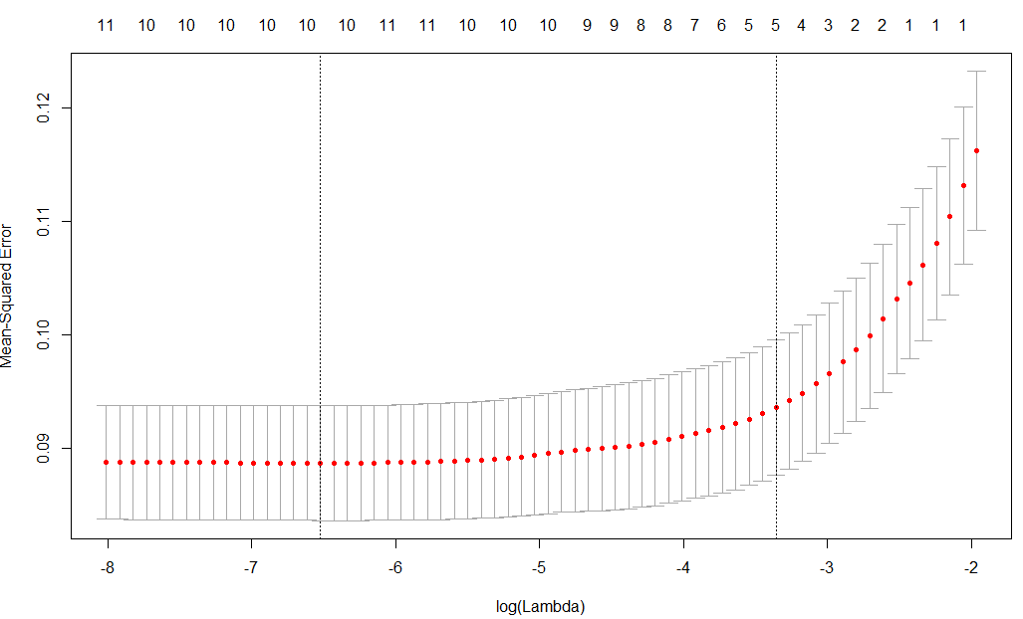
Feature Selection

Slide 29
Interpretation
Principle Component Analysis

Slide 30
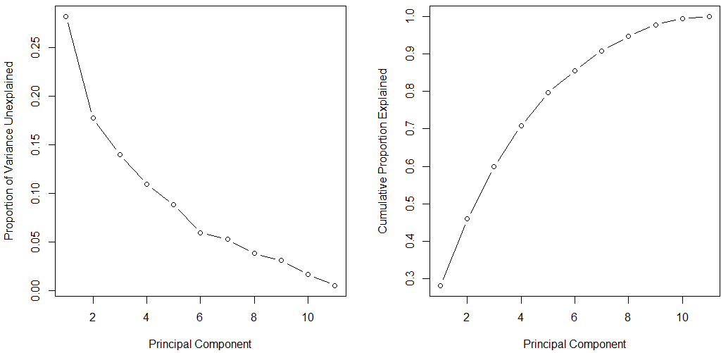
Interpretation

Slide 31
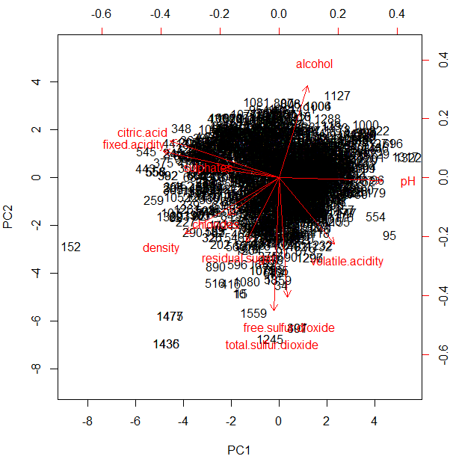
Interpretation
ANOVA Results

Slide 32
Application
Confusion Matrix
ROC
Conclusion / Recommendation

Slide 33
Type I Errors, or Type II Errors?
Type 1 Error: classifying wine as good quality when in fact it is normal
Want to avoid Type I errors. Imagine a customer pays for what she/he thinks is high quality wine, only to taste it and realize its not high quality. Very sad story!
Type II Error: classifying wine as normal quality when in fact it is good quality
Type II Error is less of a penalty in this case. Imagine a customer pays for what she/he thinks is normal quality wine, only to discover that the wine tastes excellent. This isn’t a bad scenario at all!
Notes:
Put slide in the interpretation

Slide 34
Logistic Model
Predicted Outcome
Model QDA | Negative | Positive | Total
Negative | 278 (TN) | 7 (FP) | 285 # True neg
Positive | 27 (FN) | 7 (TP) | 34 # True Pos
Total | 305 # Pred neg | 14 # Pred pos | 319 Total
True outcome
Model error % ≈ 11.2%
Type I Error % ≈ 2.45% Type II Error % ≈ 79.41%
Accuracy % ≈ 50%
Power % ≈ 20.58%

Slide 35
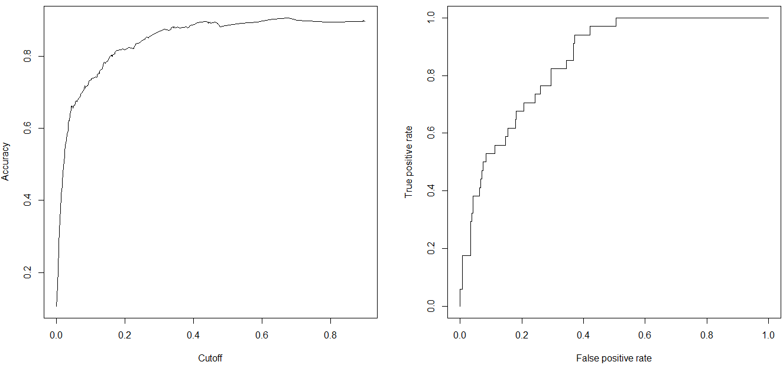
Accuracy/Power Tradeoff
The Logistic Model
AUC
Small increases in Type I, but large reduction in Type II

Slide 36
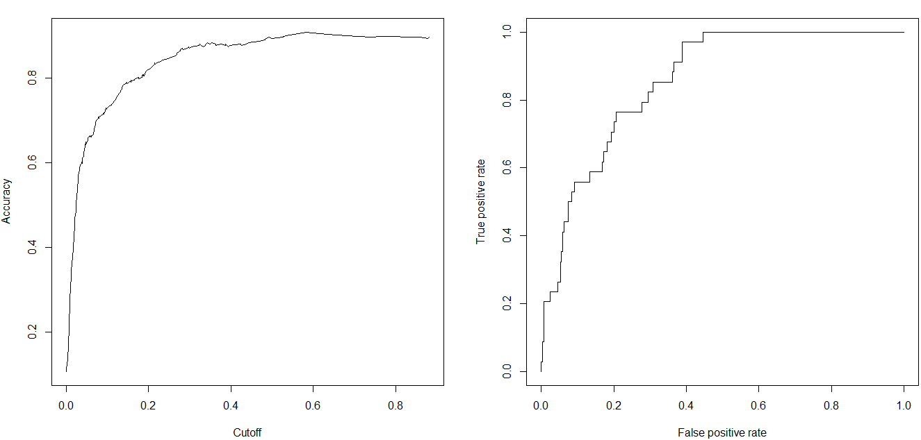
Accuracy/Power Tradeoff
The Lasso Model

Slide 37
Recommendation
Multinomial Logistic Regression
Allow for more than 2 response classes
Power Analysis
Allows a researcher to determine the needed sample size in order to obtained the required statistical power
Sample sizes is often a balance between the amount of acceptable error, detectable effect size, power, and financial cost
Set up a range of possible unknown population means and variances to see what the probability of a Type II error is for those values

Slide 38
Appendix

Slide 39
Model summary of all the MSEs
KNN:
LDA:
Logistic (all pred)
Reduced logistic regression
Reduced Logistic Regression (with higher power terms)
Ridge regression
Lasso

Slide 40
Summary of modeling steps
We fitted a variety of different models to our data
KNN, LDA, QDA, logistic (full and reduced), Ridge, Lasso
Error if always predicting the null (normal quality wine): 15%
272 true negative, and 48 true positive in the test set

Slide 41
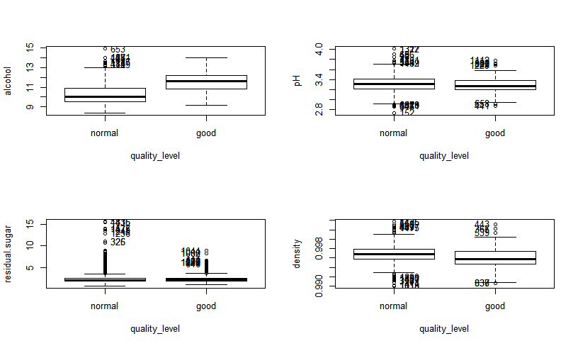
Boxplot analysis
Similar to last graph, but gives more information on spread (Q1, Q3, as well as outliers)
Notes:
Appendix slide

Slide 42
Model selection: KNN
Predicted Outcome
Model QDA | Negative | Positive | Total
Negative | 252 (TN) | 20 (FP) | 272 # True neg
Positive | 23 (FN) | 25 (TP) | 48 # True Pos
Total | 275 # Pred neg | 45 # Pred pos | 320 Total
True outcome
Model error % ≈ 17.8%
Type I Error % ≈ 7.3% Type II Error % ≈ 47.9%
Power % ≈ 52.08
Notes:
(Power <- t[4]/sum(t[2,])) #all of the correctly classified positives/all of the true positives

Slide 43
Confusion Matrix -- LDA
Predicted Outcome
Model QDA | Negative | Positive | Total
Negative | 258 (TN) | 14 (FP) | 272 # True neg
Positive | 31 (FN) | 17 (TP) | 48 # True Pos
Total | 289 # Pred neg | 31 # Pred pos | 320 Total
True outcome
Model error % ≈ 14.06%
Type I Error % ≈ 5.14% Type II Error % ≈ 64.58%
Power % ≈ 35.42%

